Slide 1
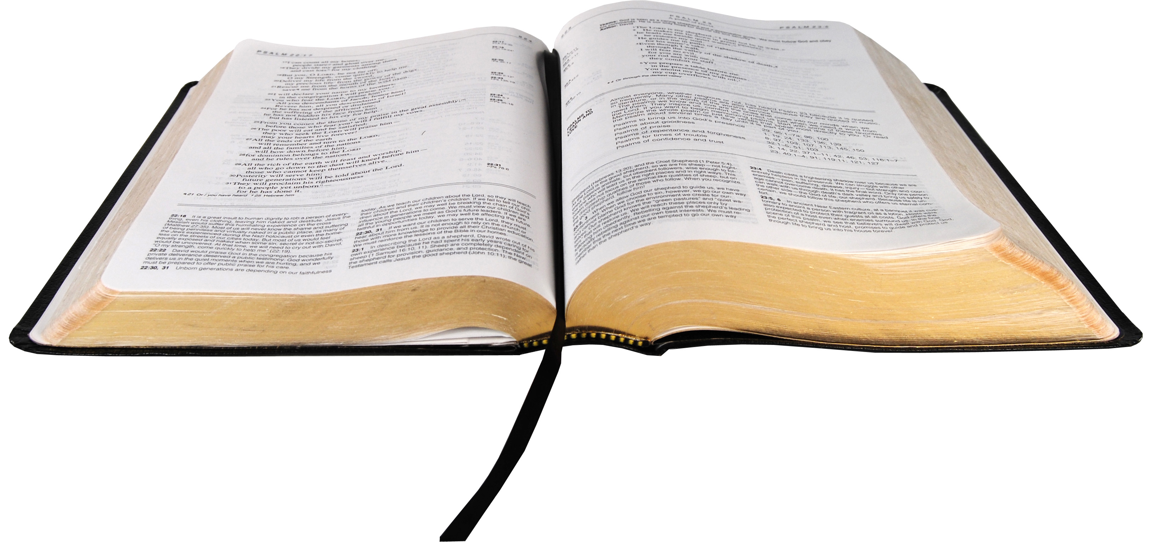
How to Feed on God’s Word
April Bible Study

Slide 2
Review Lesson One: The Importance of God’s Word

Slide 3
Seven Reasons Why The Word of God is Important to Your Life and Spiritual Growth.

Slide 4
1. All Scripture is Given by Inspiration from God.
2. The Word of God is Living and Powerful.
3. The Word of God is Pure.
4. The Word of God Sanctifies.

Slide 5
5. The Word of God will Give you Knowledge and Wisdom.
6. The Word of God is Medicine.
7. The Word of God will Stand Forever.

Slide 6
“You can't do the will of God if you don't know the Word of God.”
Jack Wyrtzen

Slide 7
Seven Analogies for the Word of God

Slide 8
1. A Sword That Pierces
Hebrews 4:12-13

Slide 9
For the word of God is living and active and sharper than any two-edged sword and piercing as far as the division of soul and spirit, of both joints and marrow, and able to judge the thoughts and intentions of the heart. And there is no creature hidden from His sight, but all things are open and laid bare to the eyes of Him with whom we have to do.

Slide 10
“The Word of God is alive; it speaks to me. It has feet, it runs after me. It has hands, it lays hold of me!”
Martin Luther

Slide 11
The Word of God is a Sword
And take the helmet of salvation, and the sword of the Spirit, which is the Word of God.
Ephesians 6:17

Slide 12
“The Word of God strips us down and makes us naked before God. It allows us to see ourselves for the very first time as God sees us.”

Slide 13
The Attitude of a Skilled Spiritual Warrior
“I have restrained my feet from every evil way, that I may keep Your word. I have not departed from Your judgments, for You Yourself have taught me. How sweet are Your words to my taste, sweeter than honey to my mouth! Through Your precepts I get understanding; therefore, I hate every false way”
Psalm 119:101-104

Slide 14
2. A Mirror that Reveals
There are Three Ministries of the Word of God as a Mirror:

Slide 15
RESTORATION - Exodus 38:8
He made the laver of bronze and its base of bronze, from the bronze mirrors of the serving women who assembled at the door of the tabernacle of meeting.

Slide 16
TRANSFORMATION - 2 Corinthians 3:18
But we all, with unveiled face, beholding as in a mirror the glory of the Lord, are being transformed into the same image from glory to glory, just as by the Spirit of the Lord.

Slide 17
EXAMINATION - James 1:23-25
For if anyone is a hearer of the word and not a doer, he is like a man observing his natural face in a mirror; for he observes himself, goes away, and immediately forgets what kind of man he was. But he who looks into the perfect law of liberty and continues in it and is not a forgetful hearer but a doer of the work, this one will be blessed in what he does.

Slide 18
3. A Seed That Reproduces
1 Peter 1:23

Slide 19
For you have been born again not of seed which is perishable but imperishable, that is, through the living and enduring word of God.

Slide 20
Mark 4:13 The Sower sows the Word
The Word of God is the seed that makes the kingdom work in our lives.

Slide 21
“I would rather speak five words out of this book than 50,000 of the philosophers”
Charles Spurgeon

Slide 22
4. Milk That Nourishes
I Peter 2:1-2

Slide 23
Therefore, laying aside all malice, all deceit, hypocrisy, envy, and all evil speaking, as newborn babes, desire the pure milk of the word, that you may grow thereby.

Slide 24
No one’s spiritual development will advance beyond their intake of the Word of God.

Slide 25
5. A Lamp That Shines
Psalm 119:105

Slide 26
Your Word is a lamp to my feet, and a light to my path.

Slide 27
This lamp is not an option for a few of us, it is a necessity for every one of us.

Slide 28
Isaiah Prophesied Jesus’ Ministry
“The people who were sitting in darkness saw a great light, and those who were sitting in the land and shadow of death, Upon them a light dawned”
Matthew 4:16

Slide 29
There was a man sent from God, whose name was John. This man came for a witness, to bear witness of the Light, that all through Him might believe. He was not that Light but was sent to bear witness of that Light. That was the true Light which gives light to every man coming into the world.
John 1:6-9

Slide 30
As long as I am in the world, I am the light of the world.”
John 9:5

Slide 31
The unfolding of your words gives light; it imparts understanding to the simple.
Psalm 119:130

Slide 32
6. A Fire That Consumes
Jeremiah 23:29
“Is not My Word like fire?”

Slide 33
“The message that we preach will cause people to either be blessed or to be burned. It will cause them to either be on fire or in the fire. They will either be on fire for God, or they will be in the fire of God, and there is no mediating position in between.”

Slide 34
7. A Hammer that Shatters
Jeremiah 23:29
…and like a hammer which shatters a rock?

Slide 35
“People are like a rock, they are hard-headed, hard-hearted, and their foreheads are like flint.”

Slide 36
The Word Charge:
Use the sword, face the mirror, scatter the seed, drink the milk, turn on the lamp, fan the flame, and swing the hammer.

